Slide 1




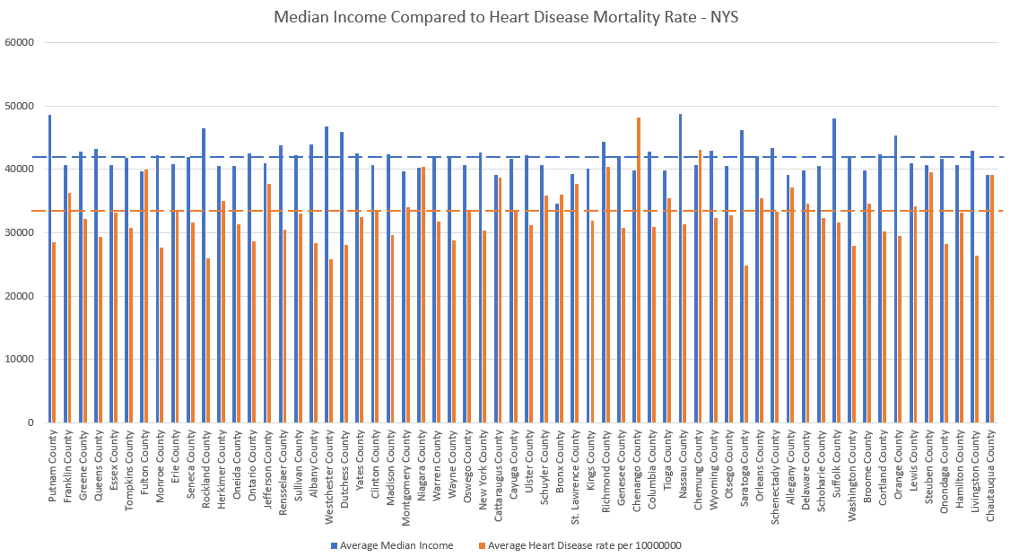
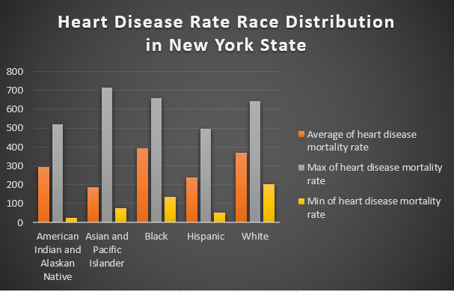
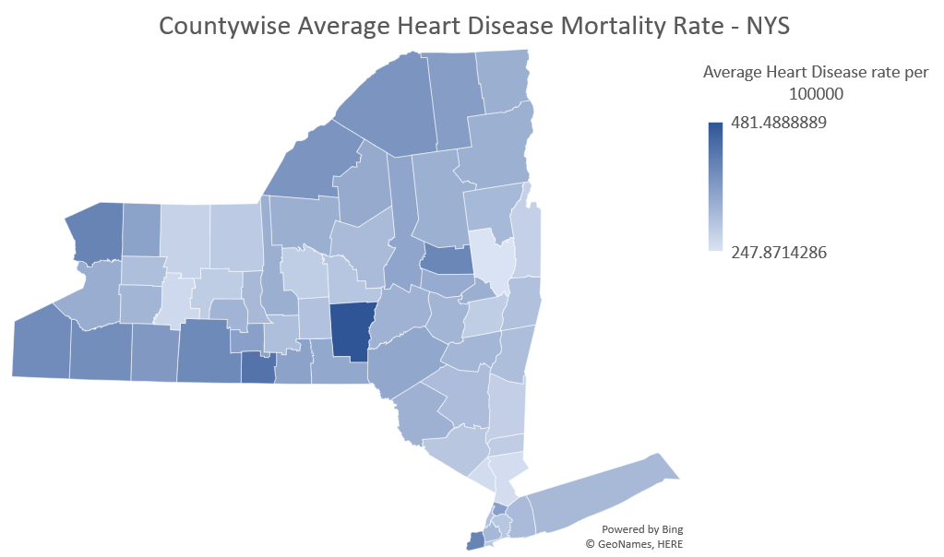
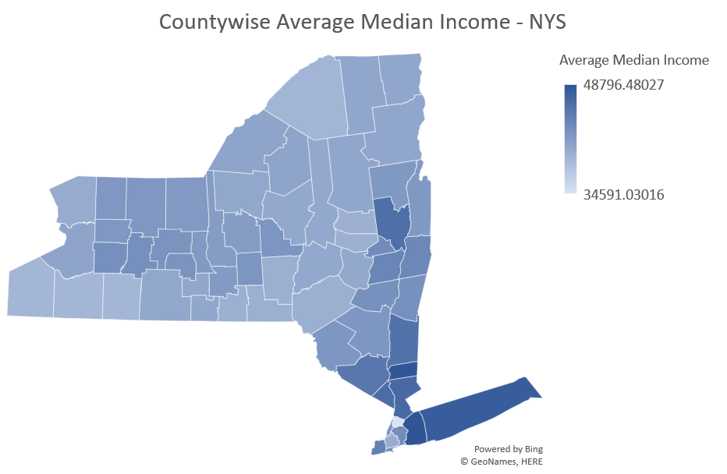
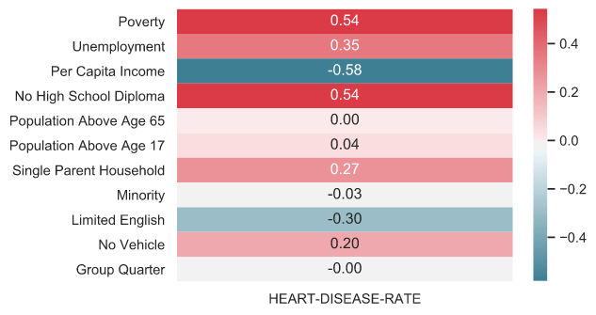
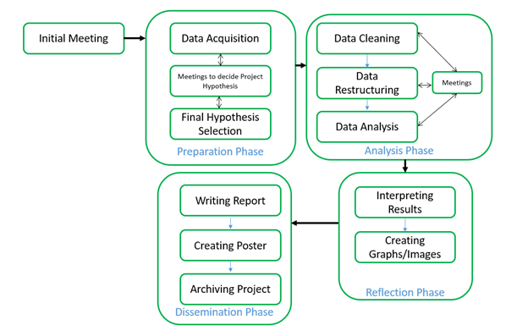
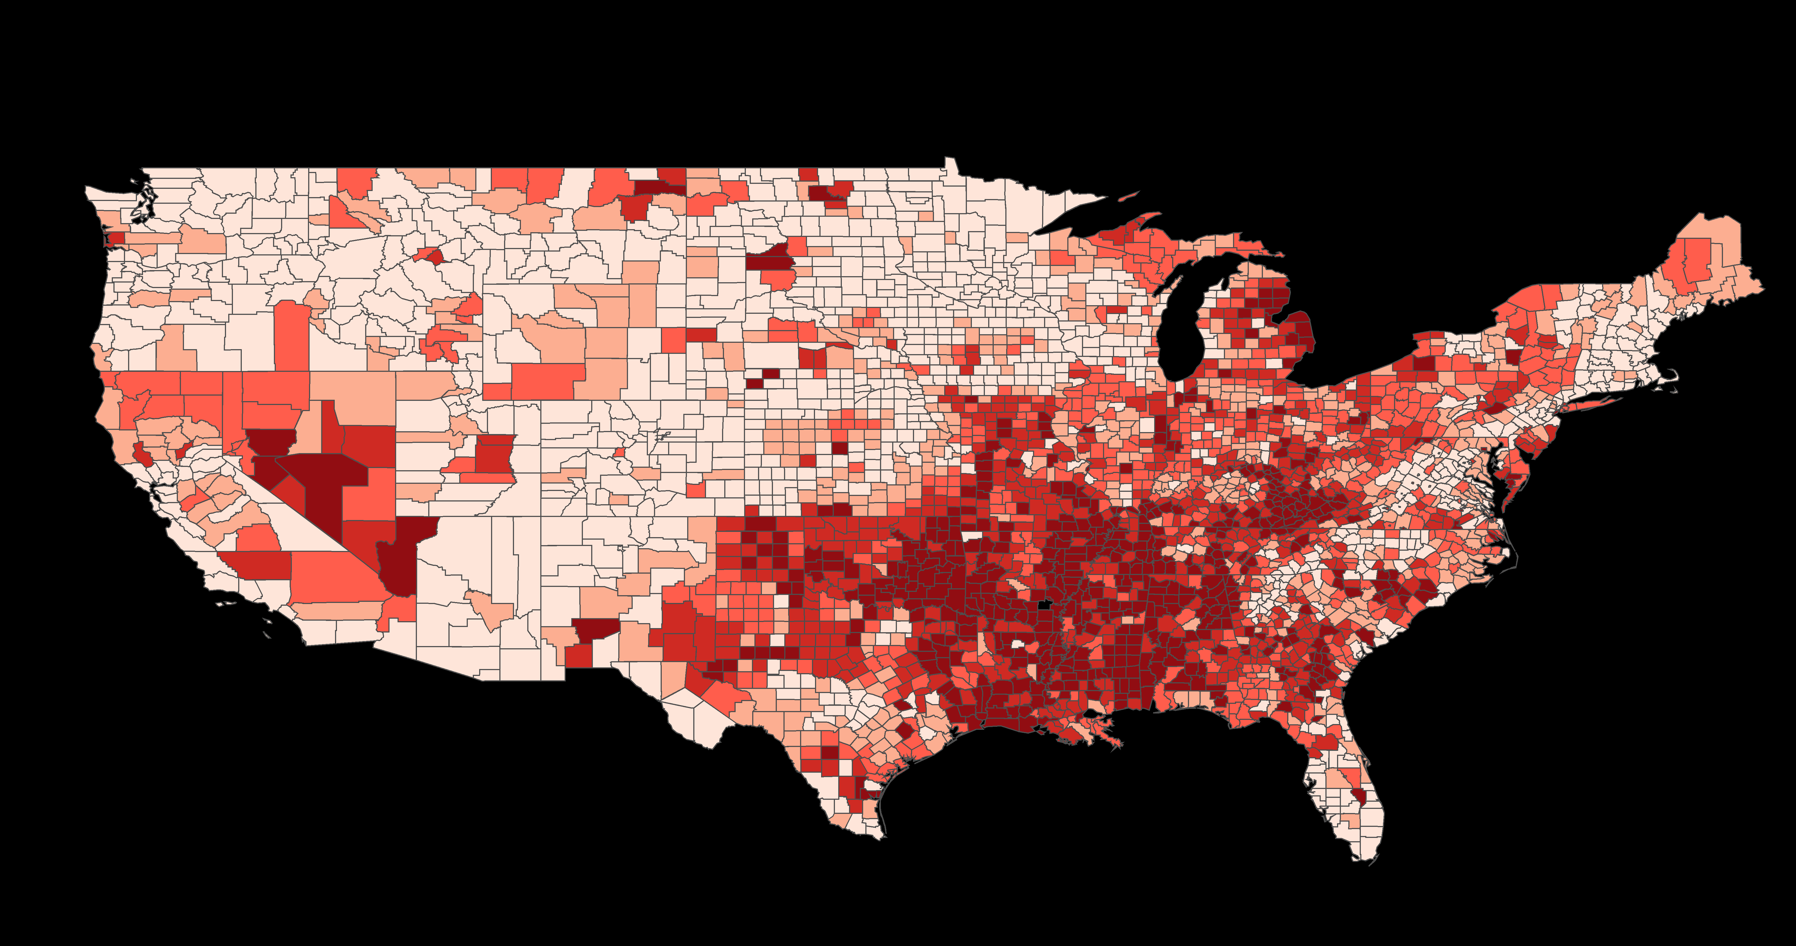
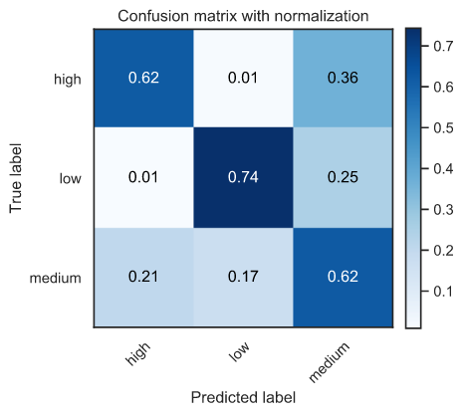
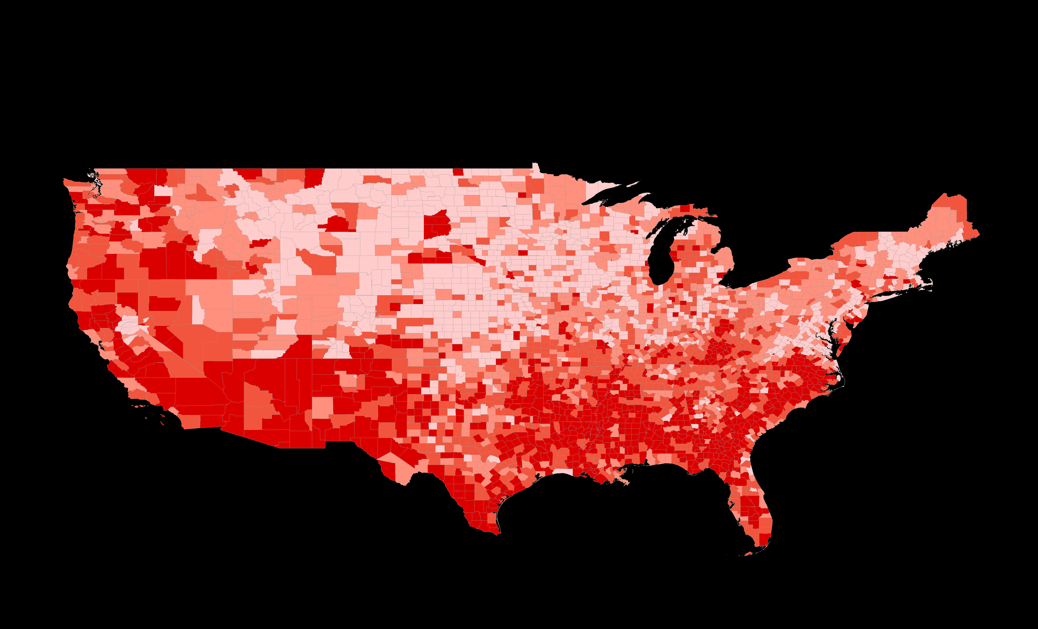
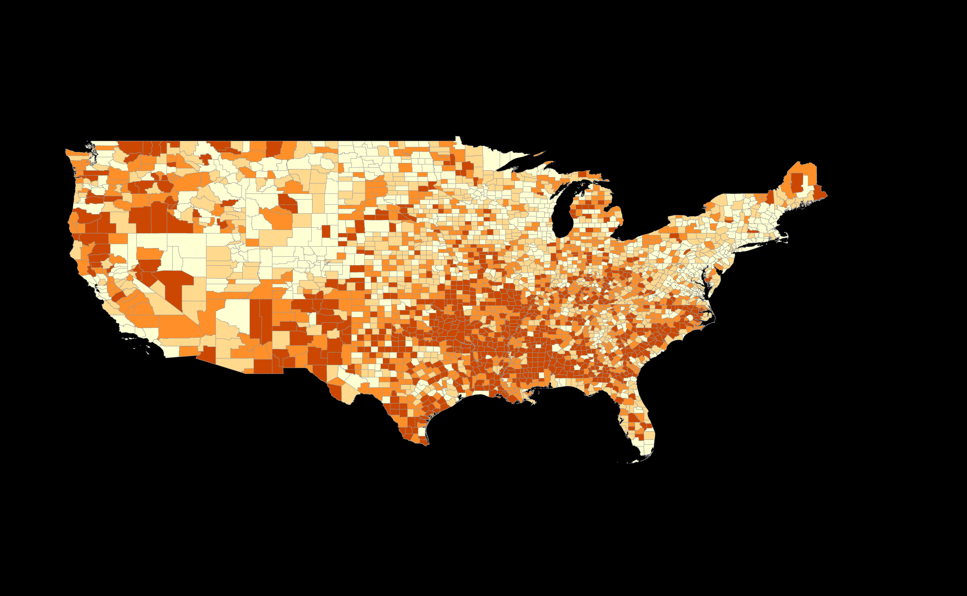
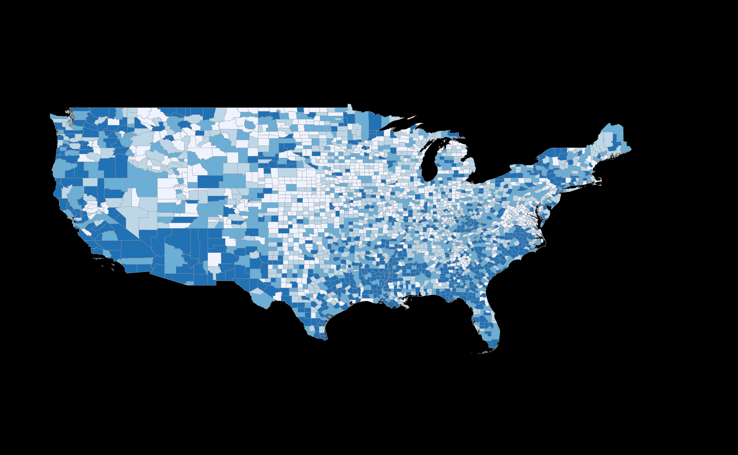
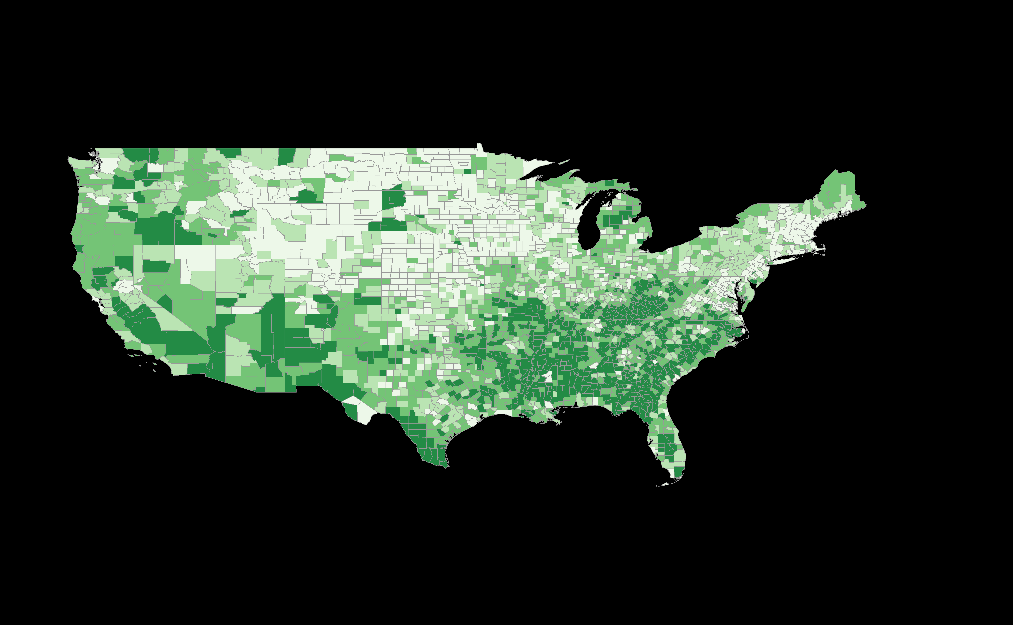


A Study of Factors Affecting Heart Disease
Mortality Rate in the United States
Ashraful Islam, Nicholas Luczak, Saswata Paul, Yiyun su
{islama6, luczan, pauls4, syu4}@rpi.edu
Rensselaer Polytechnic Institute, Tetherless World Constellation, Troy, NY, United States
Abstract
Data Analysis
In this poster, we present our investigation of the factors that may be responsible for coronary heart disease in the United States. We perform two types of analysis - an analysis of coronary heart disease and median household income for New York State, and an analysis of coronary heart disease and social determinants for the entire United States. We obtain public domain data from www.cdc.gov and www.data.gov to perform our analysis. Our preliminary analysis shows interesting patterns between coronary heart disease mortality and social factors. Moreover, we train a machine learning model to see if it is possible to correctly predict coronary heart disease from the various factors, which shows around 67% accuracy in predicting heart disease mortality from social vulnerability factors.
Relationship Between Heart Disease Rate and Median Income for New York State
Relationship Between Heart Disease Rate and Race Distribution in NYS
Learning Heart Disease Mortality from Social Vulnerability Factors
12 SVI factors were used
Correlation between heart disease mortality and SVI factors
Workflow
heart disease mortality rate is usually inversely related to median income.
Relationship Between Heart Disease Rate and Social Vulnerability
Choropleth Map
15 US census variables to determine the Social vulnerability of each county
the higher the overall vulnerability of a community the less likely they are to live a healthy lifestyle; therefore, their likelihood of coronary-related mortalities sees an increase as a result.
Heart-disease-death-rate highly correlates with poverty and no-high-school-diploma-household
Heart-disease-death-rate inversely correlates with per-capita-income and limited-English-speaking-ability
Research Questions
Machine Learning
Convert heart rate mortality values to categorical values:
Low: 0 – 320
Medium: 320 – 420
High: 420 – 800
Training data: 777 Samples
Testing data: 333 Samples
Each input feature has 12 dimension
SVM Classification
3 class SVM with RBF kernel
Test Accuracy: 66.36%
How is heart disease mortality rate connected to the median income in New York State?
How is heart disease mortality rate connected to social vulnerability in the United States?
Data Format
NYSERDA Low-to-Moderate-Income New York State Census Population Analysis Dataset
Collected from: catalog.data.gov
Type of file: CSV
Publisher: data.ny.gov
Maintainer: NY Open data
Maintainer email: openny@nyserda.ny.gov
Time: 2013-2015
Heart Disease Mortality Data Among US Adults (35+) by State/Territory and County
Collected from: catalog.data.gov
Type of file: CSV
3. Publisher: Centers for Disease Control and Prevention
4. Maintainer: NY Open data
5. Maintainer email: openny@nyserda.ny.gov
6. Time: 2013-2015
Social Vulnerability Index 2012 - 2014
Collected from: svi.cdc.gov
Type of file: CSV
Publisher: cdc.gov
Maintainer: Centers for Disease Control and Prevention
4. Maintainer email: dhdsprequests@cdc.gov
Heart disease mortality rate
Overall social vulnerability index
Household Composition and Disability
Decision Tree Classifier
Test Accuracy: 52.60%
K-NN Classifier
10 nearest neighbors
Test Accuracy: 66.36%
Housing and Transportation
Socioeconomic Status
SVM and K-NN seem to work best for this problem
From the figures, we see a clear relationship between social determinants and heart disease mortality rate.
Check our project video
Sponsors:
Resources:
www.cdc.gov, www.catalog.data.gov, www.data.ny.gov, www.svi.cdc.gov
https://matplotlib.org/3.1.1/index.html, https://seaborn.pydata.org/, https://scikit-learn.org/stable/, https://pandas.pydata.org/

